Slide 1
Data Cleaning and Preprocessing
Marziyeh Mousavi
Introduction to datascience
Fall 2024

Slide 2
Content
Handling missing Data ,outliers and duplicates
Data transformation and Normalization

Slide 3
Data Cleaning
Data cleaning, also called data wrangling, is the process of transforming raw data to facilitate subsequent analysis. It is often used to address issues like:
Unclear structure or formatting
Missing or corrupted values
Unit conversions
…and so on

Slide 4
Handling missing data
Missing Data can occur when no information is provided for one or more items or for a whole unit. Missing Data is a very big problem in a real-life scenarios. Missing Data can also refer to as NA(Not Available) values in pandas. In DataFrame sometimes many datasets simply arrive with missing data, either because it exists and was not collected or it never existed. For Example, Suppose different users being surveyed may choose not to share their income, some users may choomany datasets simply arrive with missing data, either because it exists and was not collected or it never existed. For Example, Suppose different users being surveyed may choose not to share their income, some users may choose not to share the address in this way many datasets went missing.

Slide 5
Missing Data in Python
In Pandas missing data is represented by two value:
None: None is a Python singleton object that is often used for missing data in Python code.
NaN : NaN (an acronym for Not a Number), is a special floating-point value recognized by all systems that use the standard IEEE floating-point representation.

Slide 6
Identifying Missing Data
Pandas treat None and NaN as essentially interchangeable for indicating missing or null values. To facilitate this convention, there are several useful functions for detecting, removing, and replacing null values in Pandas DataFrame :
isnull()
notnull()
dropna()
fillna()
replace()
interpolate()

Slide 7
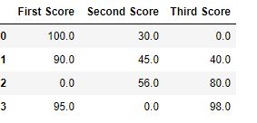
These are some examples of detecting missing datapoints
import pandas as pd
import numpy as np
dict = {'First Score':[100, 90, np.nan, 95],
'Second Score': [30, 45, 56, np.nan],
'Third Score':[np.nan, 40, 80, 98]}
df = pd.DataFrame(dict)
df.fillna(0)

Slide 8
Outliers
Outliers are the observations in a dataset that deviate significantly from the rest of the data. In any data science project, it is essential to identify and handle outliers, as they can have a significant impact on many statistical methods, such as means, standard deviations, etc., and the performance of ML models. Outliers can sometimes indicate errors or anomalies in the data.

Slide 9
What are outliers?
In statistics, any observations or data points that deviate significantly and do not conform with the rest of the observation or data points in a dataset are called outliers. Outliers are extreme values in a feature or dataset. For example, if you have a dataset with a feature height. The majority of the values in this feature range between 4.5−6.54.5−6.5 feet, but there is one value with 10 feet. This value would be considered an outlier, as it is not only an extreme value but an impossible height as well.
Outliers are also called aberrations, abnormal points, anomalies, etc. It is essential to detect and handle outliers in a dataset as it can have a significant impact on many statistical methods, such as mean, variance, etc., and the performance of the ML models. It can lead to misleading, inconsistent, and inaccurate results if they are not properly accounted for.

Slide 10
Types Of Outliers
Global Outliers
Contextual Outliers
Collective Outliers

Slide 11
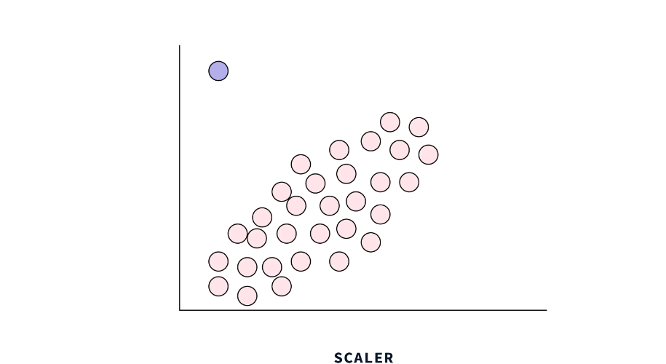
Global Outliers
It is also called point anomaly. Any observations or data points are considered as global outliers if they deviate significantly from the rest of the observations or data points in a dataset. For example, if you are collecting observations of temperatures in a city, then a value of 100 degrees would be considered an outlier, as it is an extreme as well as impossible temperature value for a city.

Slide 12
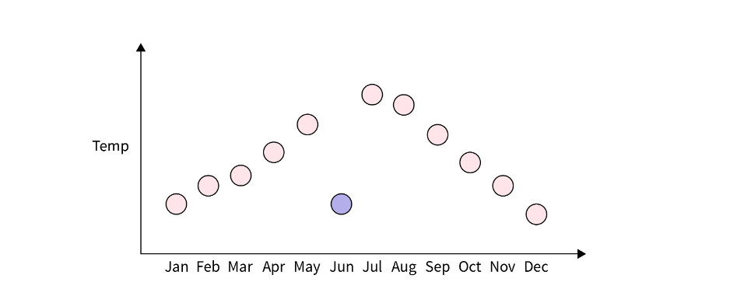
Contextual Outliers
Any data points or observations are considered as contextual outliers if their value significantly deviates from the rest of the data points in a particular context. It means that the same values may not be considered an outlier in a different context. For example, if you have observations of temperatures in a city, then a value of 40 degrees would be considered an outlier in winter, but the same value might be part of the normal observations in summer.

Slide 13
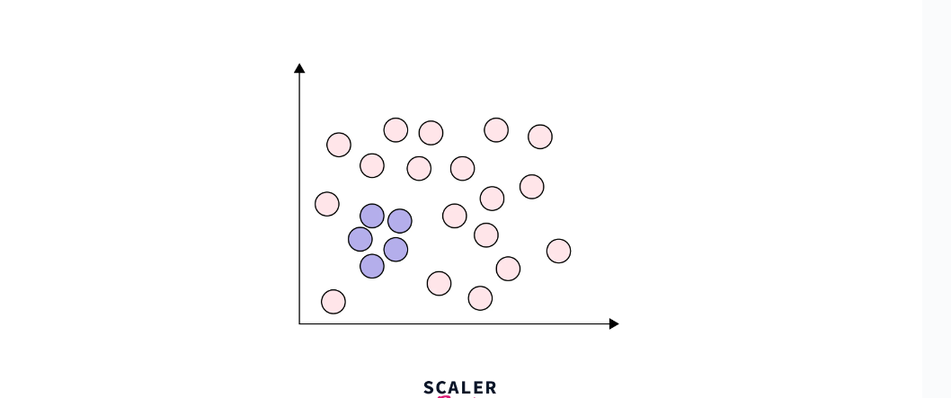
Collective Outliers
Any group of observations or data points within a data set is considered collective outliers if these observations as a collection deviate significantly from the entire data set. It means that these values, individually without collection with other data points, are not considered as either contextual or global outliers.
For example, in an Intrusion Detection System, a DOS (denial-of-service) package from one computer to another may be considered normal behavior. However, if several computers are receiving DOS packages at the same time, then this may be considered anomalous behavior, and as a collection of data points, they can be considered collective outliers.

Slide 14
Identifying Outliers
Percentile Method
Interquartile Range (IQR) Method
Z-Score Method

Slide 15
Percentile Method
The percentile method identifies outliers in a dataset by comparing each observation to the rest of the data using percentiles.
In this method, We first define the upper and lower bounds of a dataset using the desired percentiles. For example, we may use the 5th and 95th percentile for a dataset's lower and upper bounds, respectively. Any observations or data points that reside beyond and outside of these bounds can be considered outliers.
This method is simple and useful for identifying outliers in symmetrical and normal distributions.

Slide 16
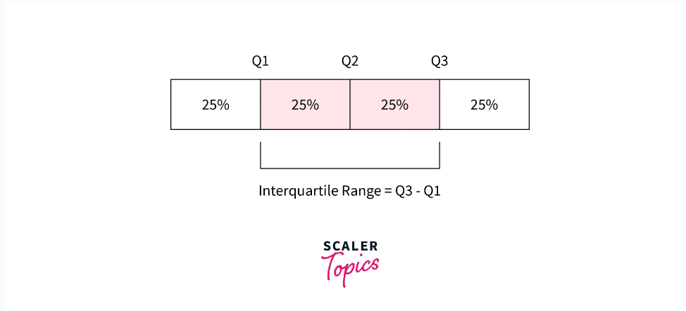
Interquartile Range (IQR) Method
The interquartile range (IQR) is a measure of the dispersion of a dataset. It is calculated by taking the difference between the upper and lower quartiles of the dataset. Quartiles are values that divide a dataset into four equal parts or quarters. The upper quartile (Q3) is the value greater than or equal to 75% of the other values in the dataset, and the lower quartile (Q1) is the value greater than or equal to 25% of the other values. The IQR is calculated by subtracting Q1 from Q3.

Slide 17
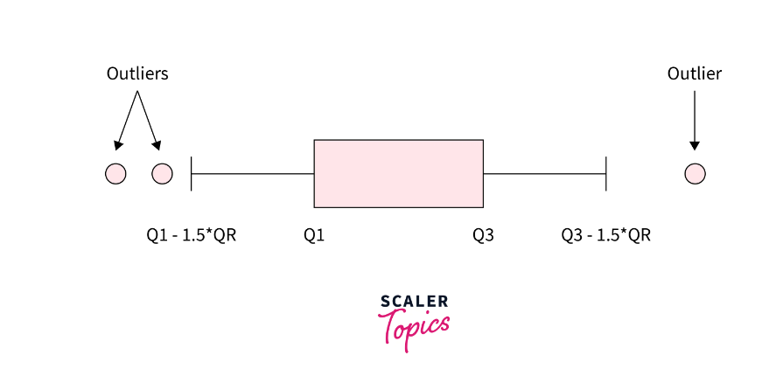
Interquartile Range (IQR) Method
Using IQR, we can define a dataset's upper and lower bounds. The upper bound is defined as Q3 + 1.5*IQR, and the lower bound is defined as Q1 - 1.5*IQR. Any observations or data points that reside beyond and outside these bounds can be considered outliers.

Slide 18
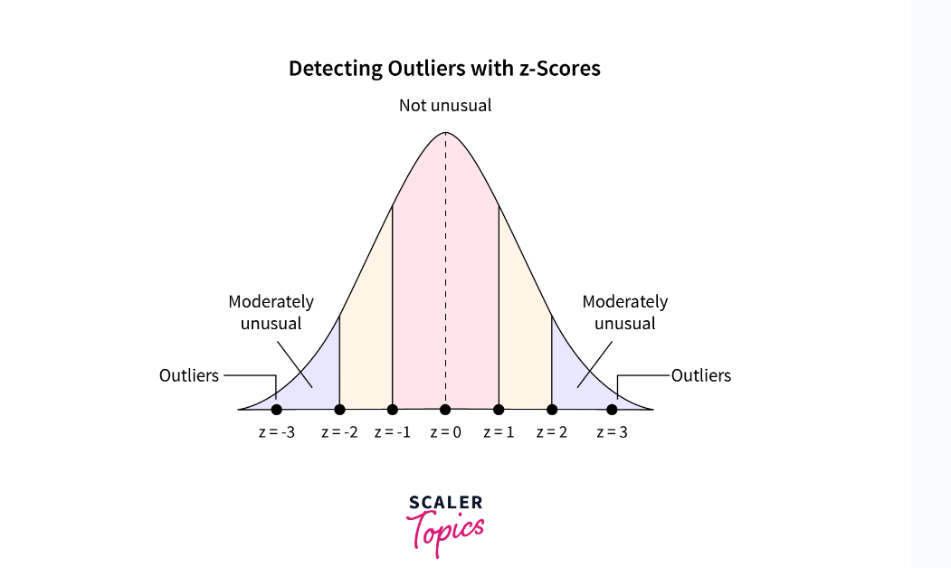
Z-Score Method
For a given value, the respective z-score represents its distance in terms of the standard deviation. For example, a z-score of 2 represents that the data point is 2 standard deviations away from the mean. To detect the outliers using the z-score, we can define the lower and upper bounds of the dataset. The upper bound is defined as z = 3, and the lower bound is defined as z = -3. This means any value more than 3 standard deviations away from the mean will be considered an outlier.

Slide 19
Let’s see one code example
import pandas as pd
import numpy as np
data = {'value': [1, 4, 11, 12, 13, 14, 15, 16, 17, 18, 19, 20, 40, 56, 73, 176]}
df = pd.DataFrame(data)
# Outlier Detection using percentile
lower = df['value'].quantile(0.05)
upper = df['value'].quantile(0.95)
outliers_percentile = df[((df['value'] < lower) | (df['value'] > upper))]
# Outlier Detection using IQR
Q1 = df['value'].quantile(0.25)
Q3 = df['value'].quantile(0.75)
IQR = Q3-Q1
outliers_iqr = df[((df['value'] < (Q1-1.5*IQR)) | (df['value'] > (Q3+1.5*IQR)))]
# Outlier detection using Z-Score
mean = np.mean(df['value'])
std = np.std(df['value'])
df['ZScore'] = (df['value'] - mean)/std
outliers_zscore = df[abs(df['ZScore']) >3]

Slide 20
How to handle Outliers?
Remove outliers
Transform outliers
Impute outliers
Use robust statistical methods

Slide 21
Remove outliers
In some cases, it may be appropriate to simply remove the observations that contain outliers. This can be particularly useful if you have a large number of observations and the outliers are not true representative
The impact of outliers can be reduced or eliminated by transforming the feature. For example, a log transformation of a feature can reduce the skewness in the data, reducing the impact of outliers
Transform outliers

Slide 22
Impute outliers
In this case, outliers are simply considered as missing values. You can employ various imputation techniques for missing values, such as mean, median, mode, nearest neighbor, etc., to impute the values for outliers.
Some of the statistical methods are less sensitive to outliers and can provide more reliable results when outliers are present in the data. For example, we can use median and IQR for the statistical analysis as they are not affected by the outlier’s presence. This way we can minimize the impact of outliers in statistical analysis.
Use robust statistical methods

Slide 23
Let’s see another code example
import pandas as pd
import numpy as np
data = {'value': [1, 4, 11, 12, 13, 14, 15, 16, 17, 18, 19, 20, 40, 56, 73, 176]}
df = pd.DataFrame(data)
# Outlier Detection using IQR
Q1 = df['value'].quantile(0.25)
Q3 = df['value'].quantile(0.75)
IQR = Q3-Q1
# Removal of Outliers
df_remove_outliers = df[((df['value'] >= (Q1-1.5*IQR)) | (df['value'] <= (Q3+1.5*IQR)))]
# Transform outliers using log transformation
df['value'] = np.log10(df['value'])
# Impute outliers - using a median technique
median_to_impute = df[((df['value'] >= (Q1-1.5*IQR)) | (df['value'] <= (Q3+1.5*IQR)))]['value'].median()
df.loc[((df['value'] < (Q1-1.5*IQR)) | (df['value'] >(Q3+1.5*IQR))), 'value'] = median_to_impute

Slide 24
Duplicates
While working on a real world dataset, we might come across very messy data which involves a lot of duplicate values. Such records do not add any value or information while using them in a model and would rather slow down the processing. So, it is better to remove duplicates before feeding the data to the model. The following method can be used to check for duplicate values in pandas

Slide 25
Identifying Duplicates
To check for duplicates, we use the “duplicated” function in Pandas.
If the df is the DataFrame, then df.duplicated() will check if the entire row has been repeated anywhere in the dataframe.

Slide 26
Code Example for identifying Duplicates
# to check for duplicate values in a particular column df.duplicated('column1') # to check for duplicate values in some specific columns df.duplicated(['column1', 'column2', 'column3')] # To check the number of duplicate values df.duplicated.sum()

Slide 27
Handling Duplicates
Once we have identified duplicates in the dataset, it is time to remove them. To delete duplicates, we use a function drop_duplicates in Pandas.
An argument “keep” can also be used with drop_duplicates. keep = ‘first’ keeps the first record and deletes the other duplicates, keep = ‘last’ keeps the last record and deletes the rest, and keep = False deletes all the records.
Note: Also, do not forget to add the argument ‘inplace’ as True to save the changes made to the dataframe.

Slide 28
Code example For Handling Duplicates
# Dropping duplicates df.drop_duplicates() # to delete duplicates from a particular column df.drop_duplicates('column1') # to delete duplicates from some specific columns df.drop_duplicates(['column1', 'column2', 'column3')]

Slide 29
Data Transformation and Normalization
Raw data comes in all kinds of strange distributions so sometimes it is difficult to analyze and especially to create models without some preprocessing. There are a variety of ways to shape the data into a more favorable input.
The overall goal of transforming our data is to create a more normal (*Gaussian*) distribution aka a bell curve. In general, normal distributions tend to produce better results in a model because there are about equal observations above and below the mean and the mean and median are the same. Models run under the assumption your data is normally distributed.

Slide 30
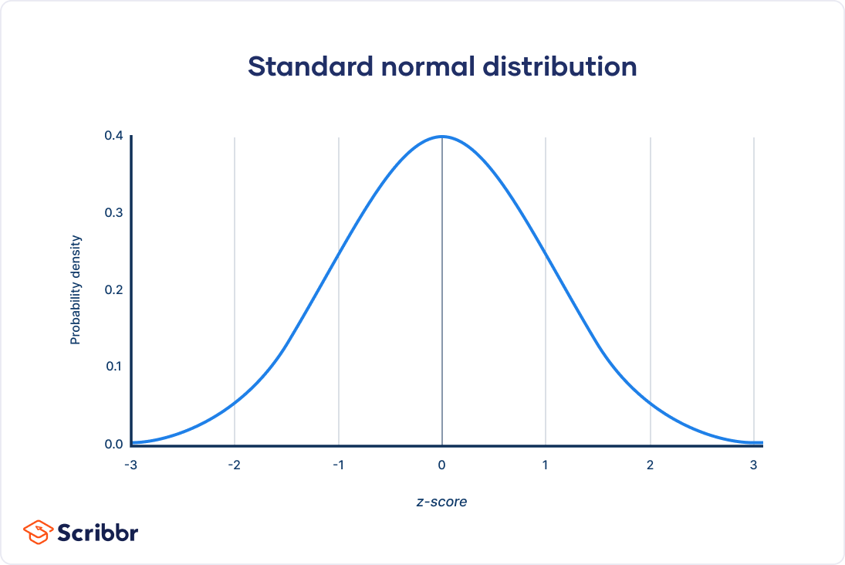
Data Transformation and Normalization
The overall goal of transforming our data is to create a more normal (*Gaussian*) distribution aka a bell curve. In general, normal distributions tend to produce better results in a model because there are about equal observations above and below the mean and the mean and median are the same. Models run under the assumption your data is normally distributed.

Slide 31
Scaling
In practice, we often encounter different types of variables in the same dataset. A significant issue is that the range of the variables may differ a lot. Using the original scale may put more weights on the variables with a large range. In order to deal with this problem, we need to apply the technique of features rescaling to independent variables or features of data in the step of data pre-processing.
The goal of applying Feature Scaling is to make sure features are on almost the same scale so that each feature is equally important and make it easier to process by most ML algorithms

Slide 32
Normalization and Transformation Techniques
Min-Max normalization
Z-score normalization

Slide 33
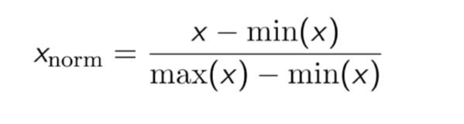
Min-Max normalization
This technique is to re-scales features with a distribution value between 0 and 1. For every feature, the minimum value of that feature gets transformed into 0, and the maximum value gets transformed into 1. The general equation is shown below:

Slide 34
Implementation using python
from sklearn.preprocessing import MinMaxScaler
scaler = MinMaxScaler()
scaler.fit(df)
scaled_features = scaler.transform(df)
#Convert to table format - MinMaxScaler
df_MinMax = pd.DataFrame(data=scaled_features, columns=["Age", "Salary","Purchased","Country_France","Country_Germany", "Country_spain"])

Slide 35
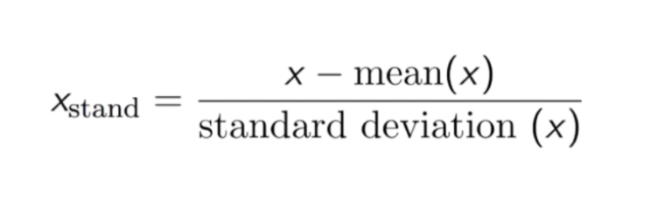
2.Z-score normalization
This technique is to re-scale features value with the distribution value between 0 and 1 is useful for the optimization algorithms, such as gradient descent, that are used within machine learning algorithms that weight inputs (e.g., regression and neural networks). Rescaling is also used for algorithms that use distance measurements, for example, K-Nearest-Neighbours (KNN)

Slide 36
Implementation in python
#Import library
from sklearn.preprocessing import StandardScaler
sc_X = StandardScaler()
sc_X = sc_X.fit_transform(df)
#Convert to table format - StandardScaler
sc_X = pd.DataFrame(data=sc_X, columns=["Age", "Salary","Purchased","Country_France","Country_Germany", "Country_spain"])

